Slide 1
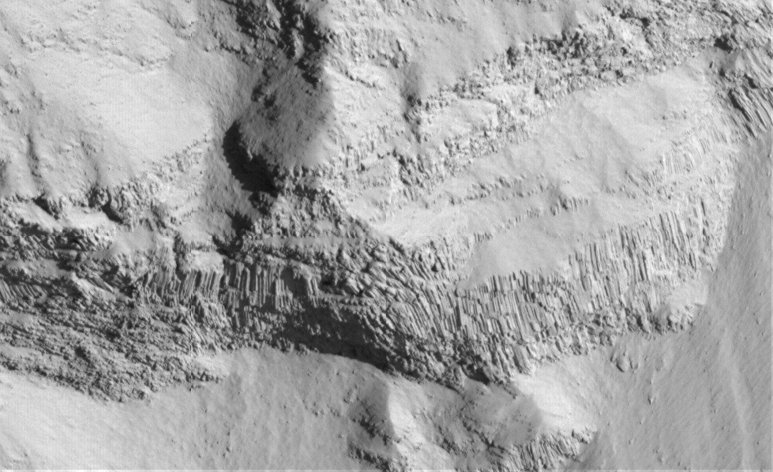


Searching for Columnar Jointing on Mars
25 cm/pixel
Brittany Meucci
Mentor- Dr. Moses Milazzo
Northern Arizona University-NASA Space Grant
Notes:
Good afternoon everyone. My name is Brittany Meucci I am from Northern Arizona University and am working on my Bachelors in Geology. For the past few months I have been working under Dr. Milazzo formerly of the USGS on the Search for Columnar jointing on Mars.

Slide 2
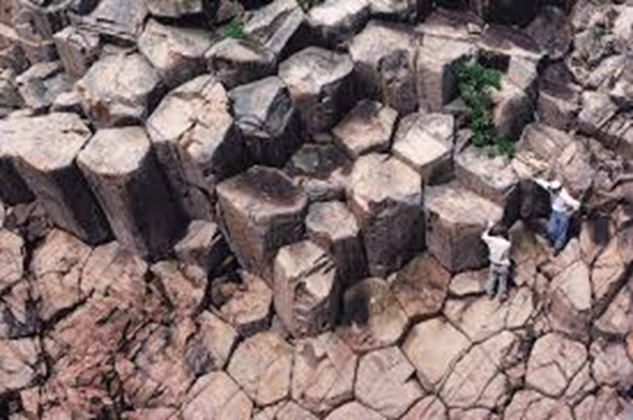
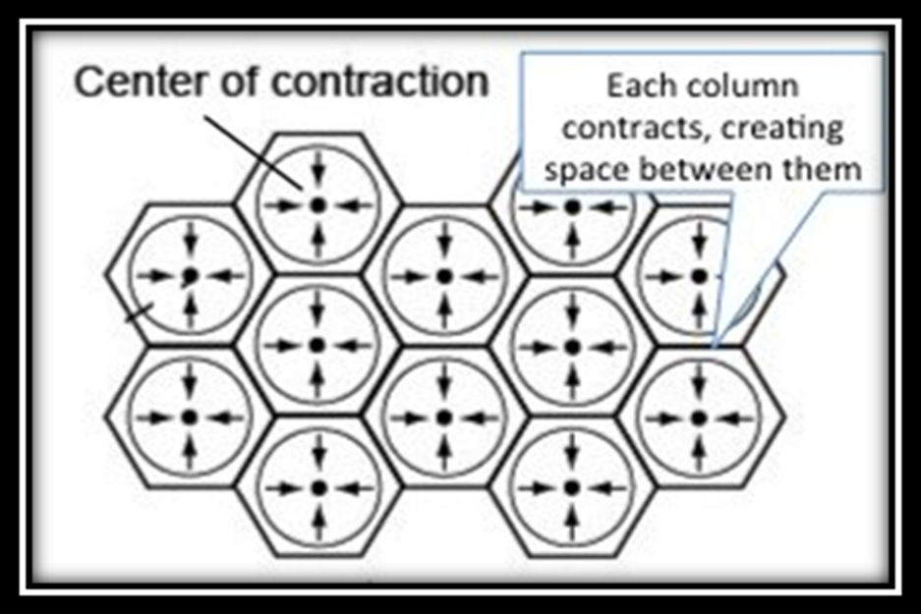
What is Columnar Jointing?
North Ninepin Island, Hong Kong
Notes:
Columnar jointing is a process where lava interacts with water. When the lava comes into contact with the water it cools much more rapidly than usual. Because it cools so rapidly it forms columns. These columns contract creating space between them. Columns are typically six sided and have a 120 degree angle between adjacent sides. But columns can appear in 4 to 7 sides.

Slide 3
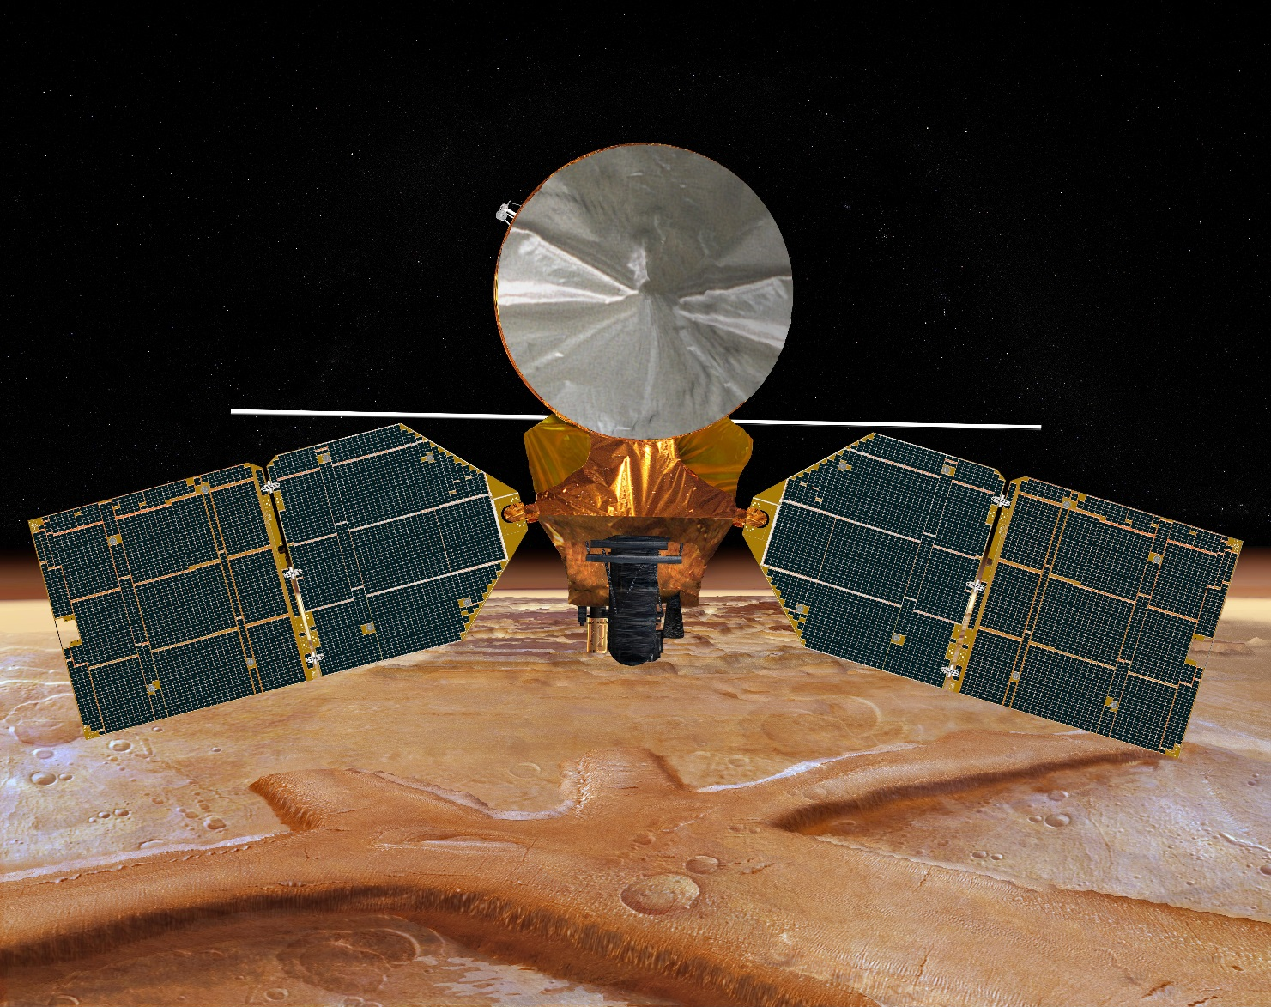
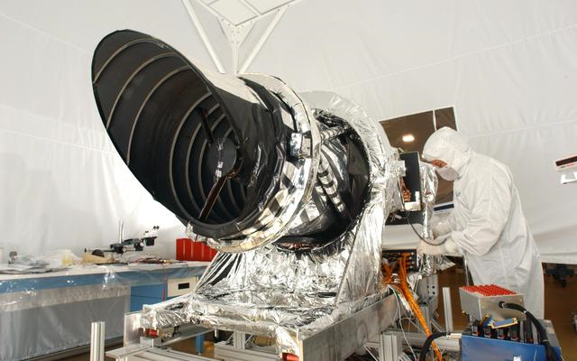
High Resolution Imaging Science Experiment (HiRISE)
On board the MRO
~1 % canvassed
30,000 + photos
370-400 km above Mars
1 m objects
Notes:
High Resolution Imaging Science Experiment, also known as, HiRISE, is a camera on board the Mars Reconnaissance Orbiter (MRO) is how the columnar jointing was discovered. Only ~1% of Mars has been canvassed but there are approximately 30,000+ photos that have been taken. The HiRISE sees in 400-1000 nanometers just a tad better than the human eye that sees at 300-700 nanometers. It is the highest resolution lens to orbit Mars and is one of the largest telescopes to leave Earth’s orbit. HiRISE allows us to see 1 meter sized objects on Mars’ surface from 370-400 km above the surface.

Slide 4
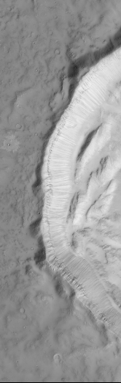
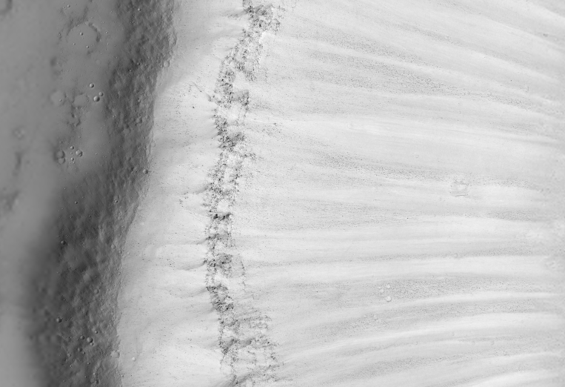
Where is it?
- Impact processes
- Volcanic processes
- Crater walls
25 cm/pixel
25 cm/pixel
Notes:
Columnar jointing on Mars is found in the crater walls. It is only found here because when an object impacts with Mars’ surface the layers are tilted laterally and exposed. It is possible the joints are present elsewhere but with the surface conditions of Mars, we can not see the joints unless something, like an impact, removes the dust layers or exposes the rock. In the online database the photos can be found under Volcanic processes or Impact processes. For the duration of the project I have canvassed photos in both categories and contributed to the list of definite, maybe, and no for where this is occurring.

Slide 5
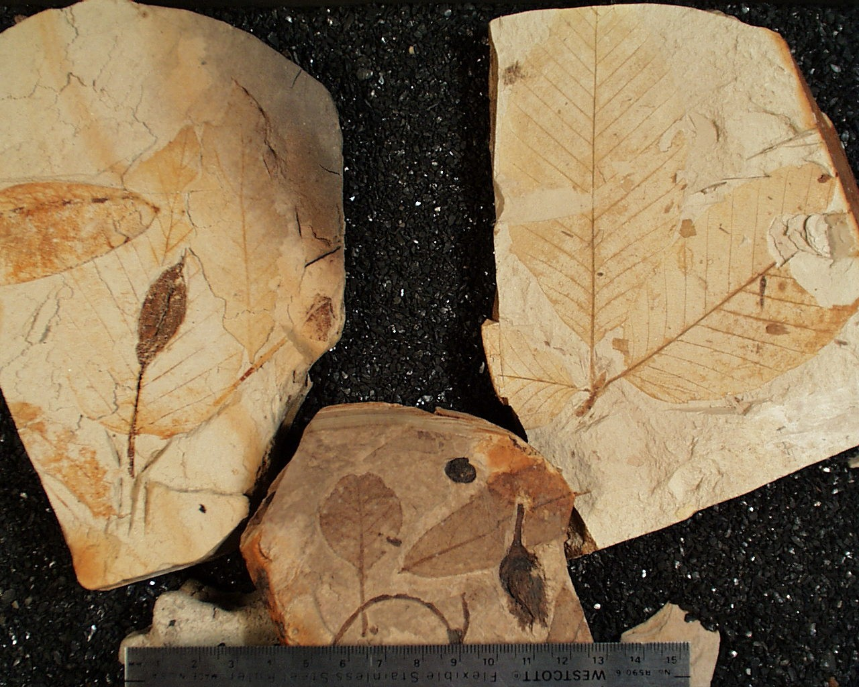
Importance
-Previous life
-Fresh water lake deposits
Notes:
Lava flows like water, it follows the path of gravity. Because lava does this, it is very likely it will come into contact with a river or other body of water. When the lava comes into contact with a river it can dam the river and create a bowl for water to fill in and eventually create a lake. It has been evident in Clarkia, Idaho that once the river dries up, the fossils are very well persevered. It is highly likely that a river was dammed but lava on Mars but no dry lake beds have been discovered yet. If a lake bed were to be found, it is safe to say that fossils may one day be found on Mars.

Slide 6
Conclusions
Lava-water interaction
Discovered by MRO’s HiRISE
~1% canvassed
Found only in impact processes
Life on Mars

Slide 7
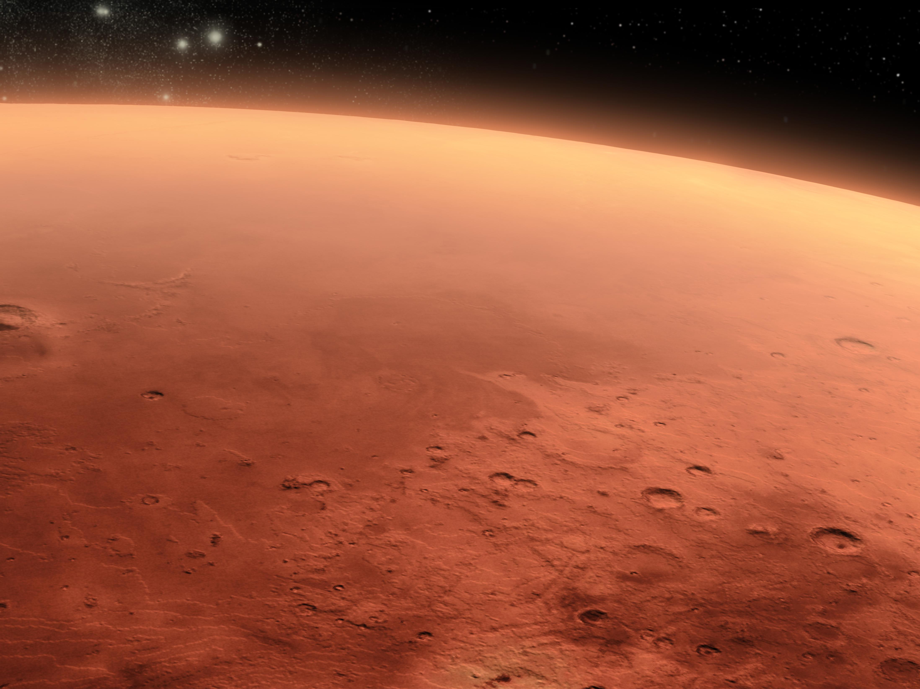
Future Research
Notes:
Looking to future research we will hopefully be able to compare Mars with Earth jointing. Doing studies on Mars helps to understand what processes previously occurred on Earth.

Slide 8
Acknowledgements
NASA Space Grant program
Northern Arizona University
Dr. Barlow and Mrs. Stigmon
And a special thanks to my mentor, Dr. Milazzo
Questions?
Notes:
I want to thank NASA Space Grant internship and Dr. Barlow and Mrs. Stigmon

